Slide 1

Digital Portfolio
STUDENT NAME: A.CHANDURU
REGISTER NO AND NMID: 42E0DFE807AB7C892B14AFE5AC3540F4
DEPARTMENT: BSc information technology
COLLEGE: KAMADHENU ART'S AND SCIENCE COLLEGE/BHARATHIAR UNIVERSITY
1
Notes:
1

Slide 2

PROJECT TITLE
Interactive Student Portfolio Website
2

Slide 3



AGENDA
1.Problem Statement
2.Project overview
3.End Users
4.Tools and Technologies
5.Portfolio design and Layout
6.Features and Functionality
7.Results and Screenshots
8.Conclusion
9.Github Link
3/21/2024 Annual Review
3

Slide 4

PROBLEM STATEMENT
In today’s competitive world, having a personal portfolio is essential for showcasing skills, education, and projects in a professional and interactive way. A simple résumé is not enough to highlight technical abilities and creativity. Therefore, this portfolio was developed to serve as an online presence and a demonstration of my web development skills.
4

Slide 5

PROJECT OVERVIEW
The Portfolio Website is a personal web application designed to showcase my academic background, technical skills, and project experience in a professional and interactive manner. The goal of this project is to establish a strong online presence and create a digital résumé that reflects both my technical expertise and creativity.
5

Slide 6

WHO ARE THE END USERS?
Recruiters & Hiring Managers: To evaluate my technical skills and projects.
Peers & Collaborators: To explore my work and potentially collaborate on projects.
Educators & Mentors: To track my progress and provide guidance.
General Audience: Anyone interested in learning about my skills, projects, and background
6

Slide 7

TOOLS AND TECHNIQUES
Frontend: HTML5, CSS3, JavaScript
Frameworks/Libraries: React (future integration possibility)
Backend (for projects): Node.js, Socket.io
Version Control: Git & GitHub
Design: Responsive web design principles, CSS Flexbox/Media Queries
7

Slide 8
POTFOLIO DESIGN AND LAYOUT
Header: Contains my name and a tagline (Computer Science Student | Web Developer).
Navigation Bar: Sticky navigation with links to all sections.
Sections: About Me, Education, Skills, Projects, and Contact.
Responsive Layout: Adjusts seamlessly to desktop, tablet, and mobile screens.
Color Scheme: A professional dark theme (blue-gray header/nav) with accent green highlights (#18bc9c).
8

Slide 9
FEATURES AND FUNCTIONALITY
About Me Section: A brief introduction and career goals.
Education Section: Academic qualifications with timeline.
Skills Section: Visual tags for technical skills.
Projects Section: Expandable/collapsible project details using JavaScript.
Contact Section: A functional form with validation and submission acknowledgment.
Interactivity: Smooth hover effects, responsive UI, and keyboard accessibility.

Slide 10
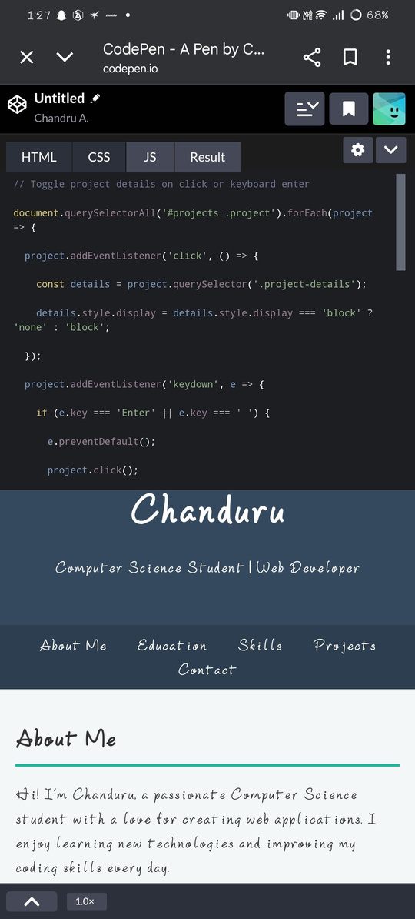
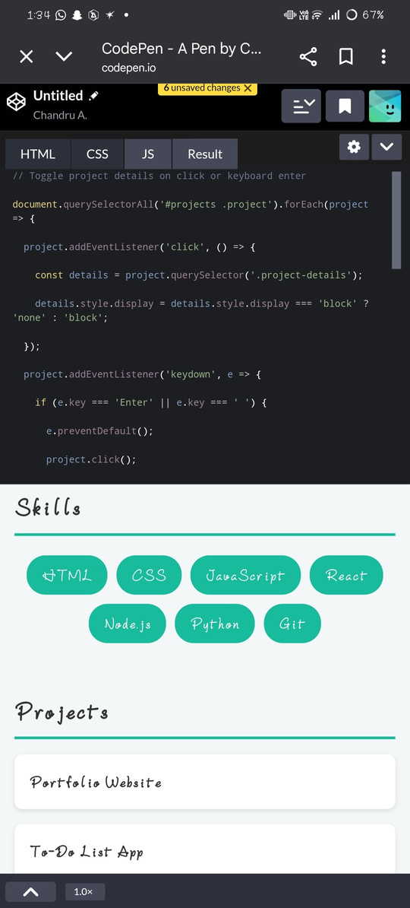
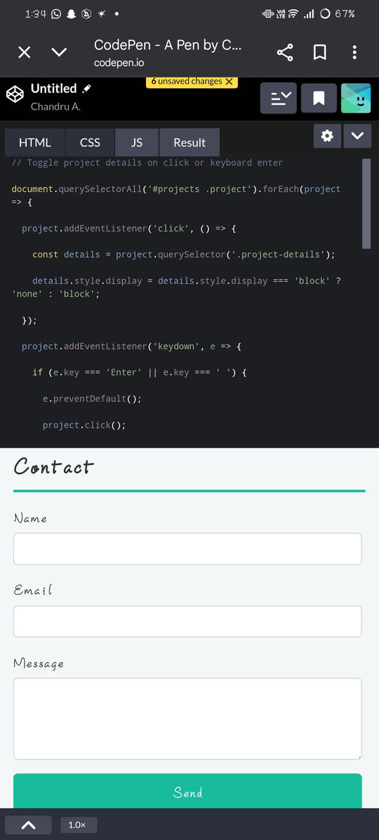
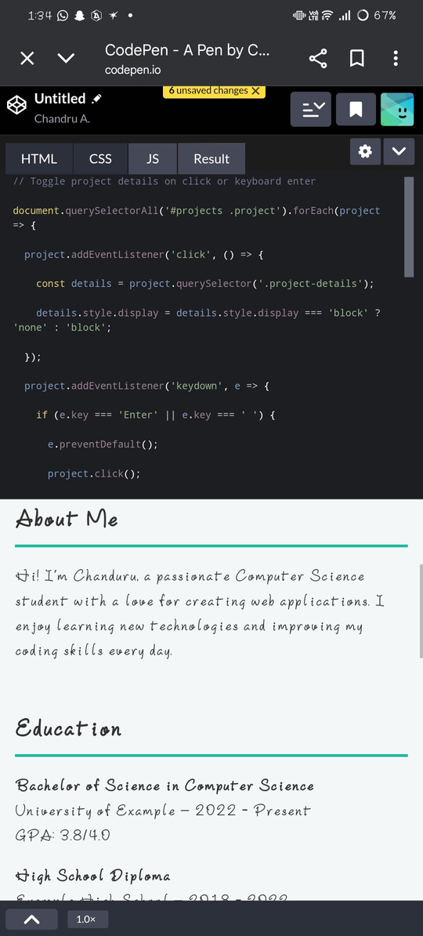
RESULTS AND SCREENSHOTS
3/21/2024 Annual Review
10

Slide 11
CONCLUSION
This portfolio not only acts as a digital résumé but also demonstrates my ability to design and develop responsive, user-friendly, and functional websites. It reflects my technical skills, creativity, and dedication to continuous learning. Going forward, I plan to integrate React and deploy the site on GitHub Pages/Netlify for wider accessibility.
11

